Slide 1


Slide 2
What we want to measure?

Slide 3
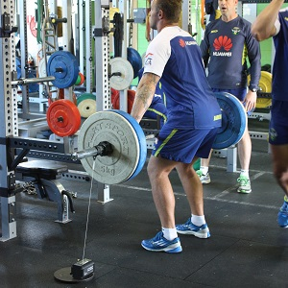
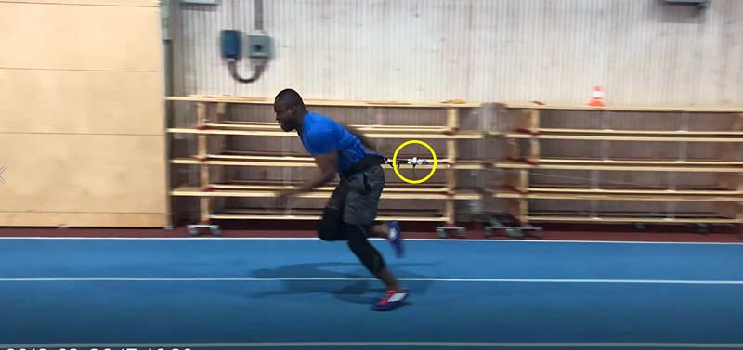

Slide 4
Currently available options

Slide 5

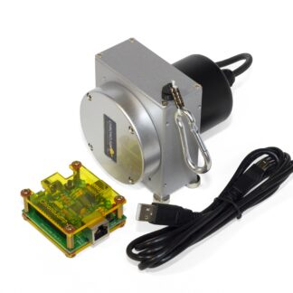
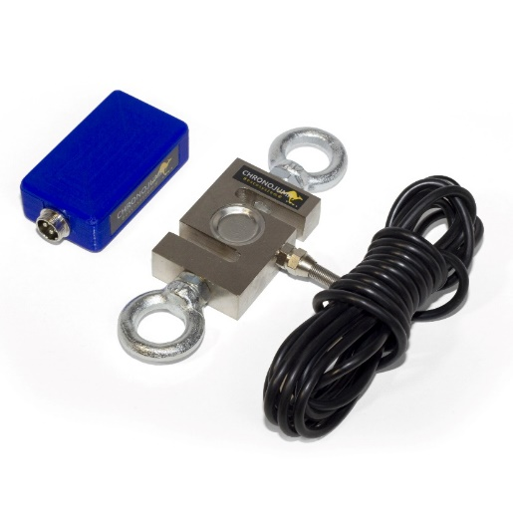
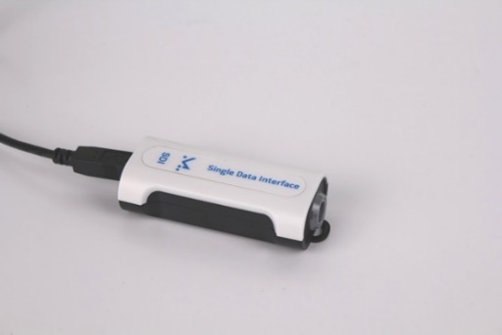
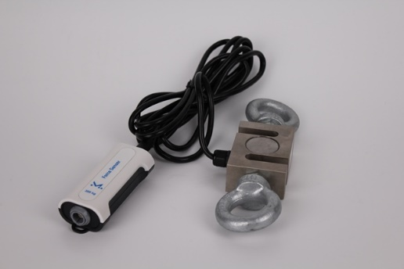
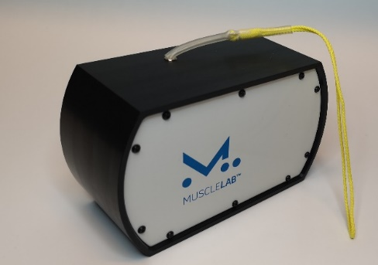


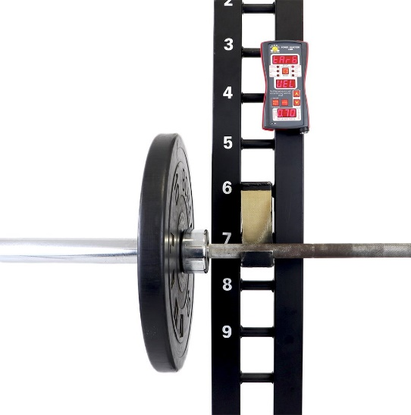

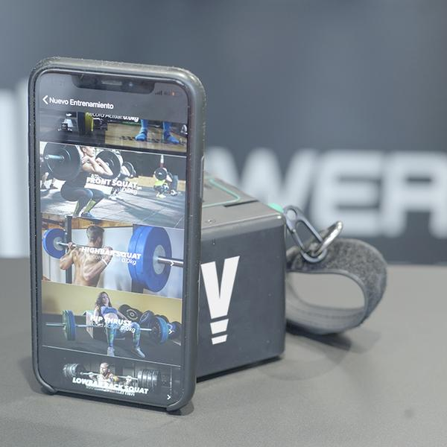
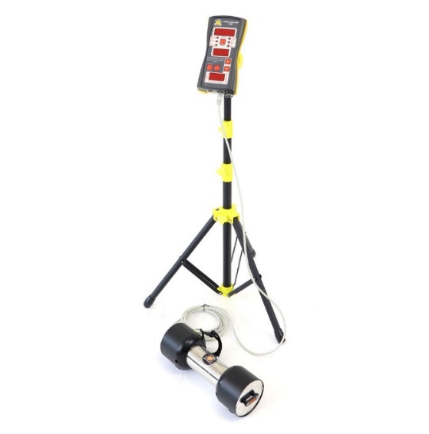
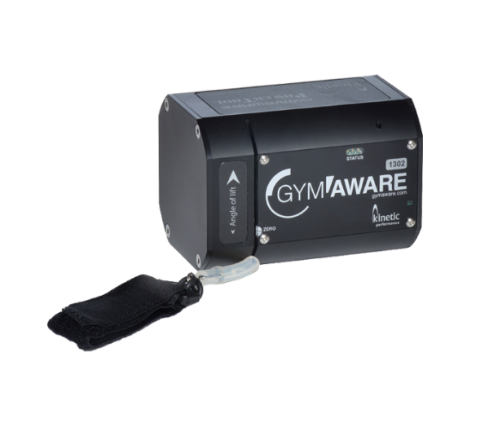
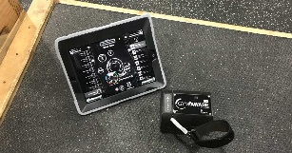
Encoder
Load cell
Data acquisition unit
Load cell
Encoder
485.00 $
1,059.00 $
1,787.36 $
€601.25
€302.26
Encoder
Encoder
Encoder
€397.00
$1,329.00
2,134.80 £

Slide 6
Availability of load cell and linear/rotational encoders
Cost around €900 for both sensors
Open source software
Great software with lots of analysis features and global database
Encoder
Need for a computer to collect the data
Need for specific hardware associated with each sensor
Not ideal for daily usage (Real time feedback)
No battery powered
No wireless connection
Load cell

Slide 7
Data acquisition unit
Availability of load cell and linear/rotational encoders
Cost over $3000 for both sensors
Historically pioneers and most used package in research
Encoder
Need for a computer to collect the data
Need for specific hardware associated with each sensor
Extremely unaffordable
Not ideal for daily usage (Real time feedback)
No battery powered
Load cell

Slide 8
Cheapest commercial device
Application to monitor and record activity
Bluetooth connectivity
Long life battery
App only available for IOS smartphones
No load cell availability, just encoder

Slide 9

Real time visual feedback (Kaiser like)
Bluetooth connectivity with an extra $355 device
No load cell availability
Segment display
Requires cable connection with a computer to store data

Slide 10
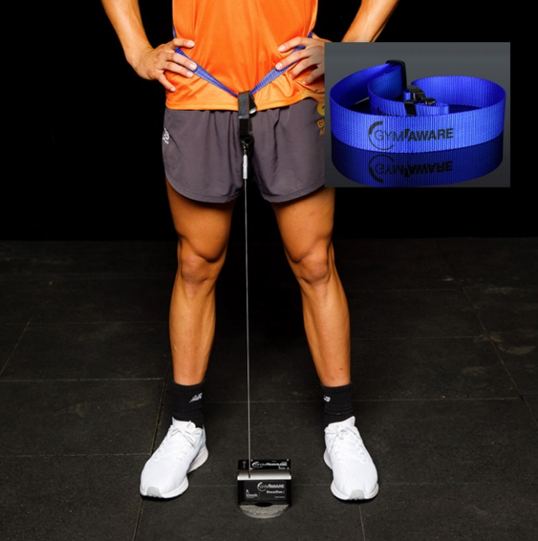
Bluetooth connectivity
Good App
Application to monitor and record activity
Unaffordable > £2000
No load cell availability

Slide 11
Manufacturing and assembly instructions

Slide 12
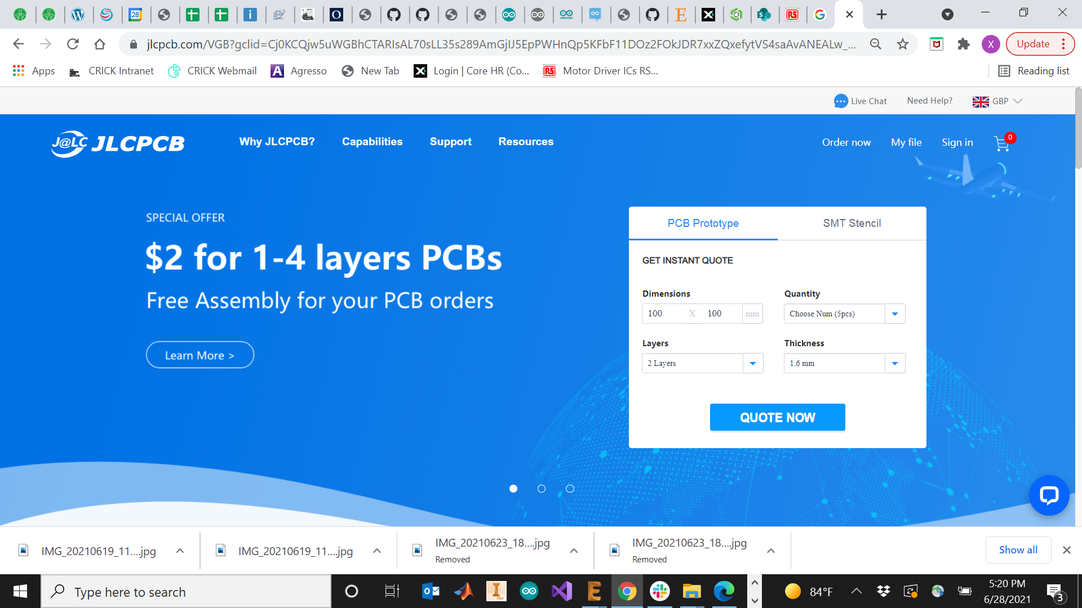
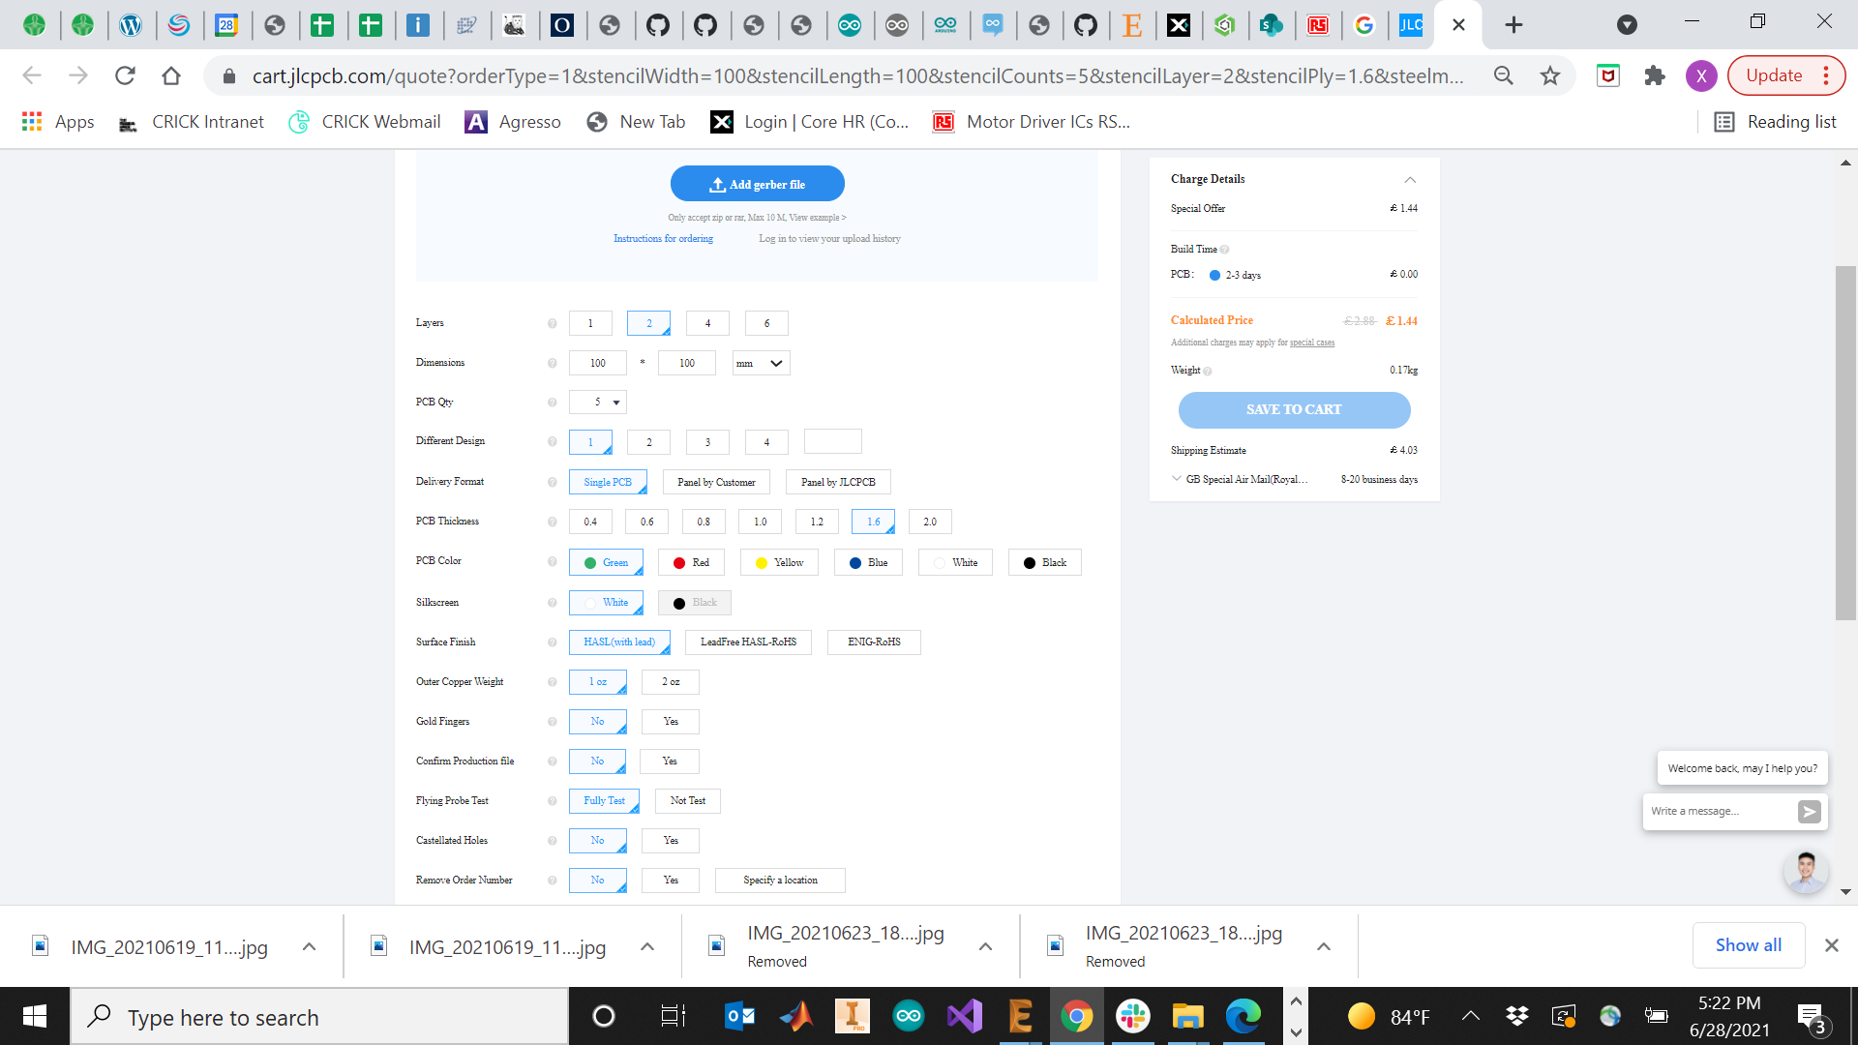
PCB ordering (JLCB PCB)

Slide 13
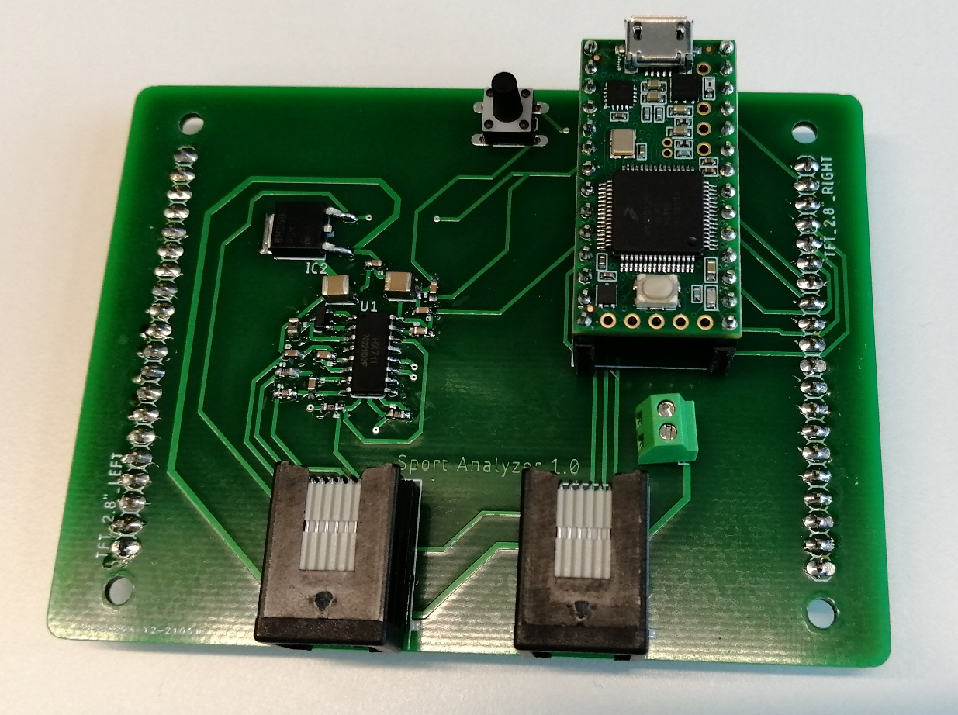
PCB soldering
Pushbutton
Teensy 3.2 Development board
Load cell amplifier circuit
Power supply connection
Encoder and Load cell Connections

Slide 14
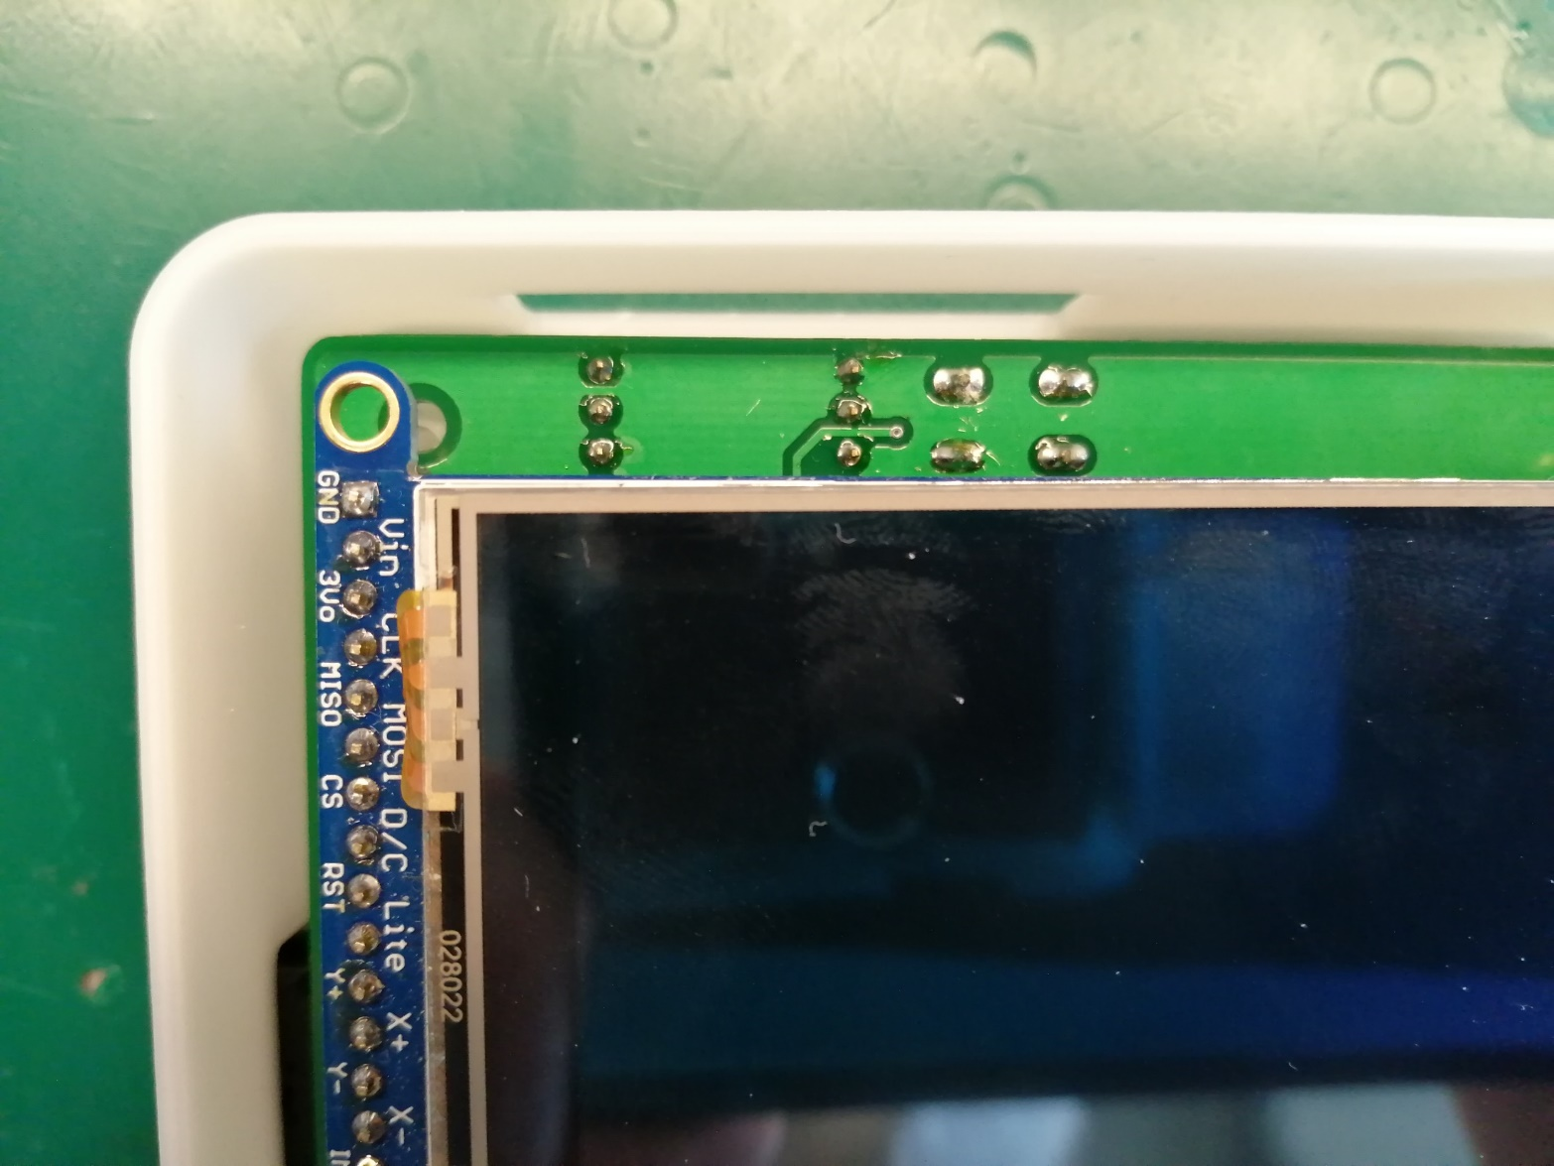
Screen placing
Pushbutton
Display wiring

Slide 15
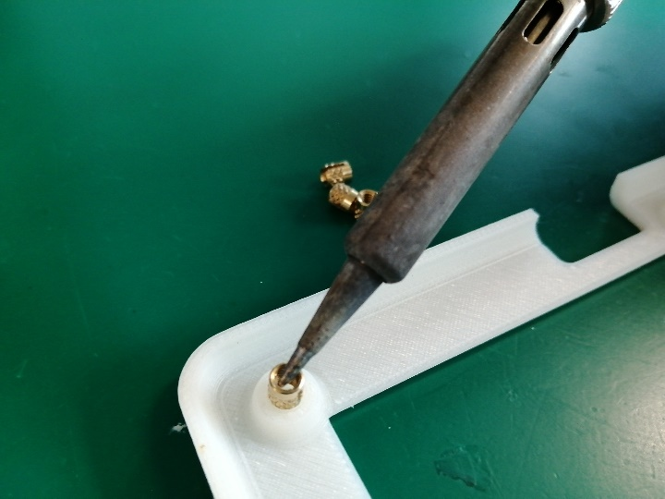
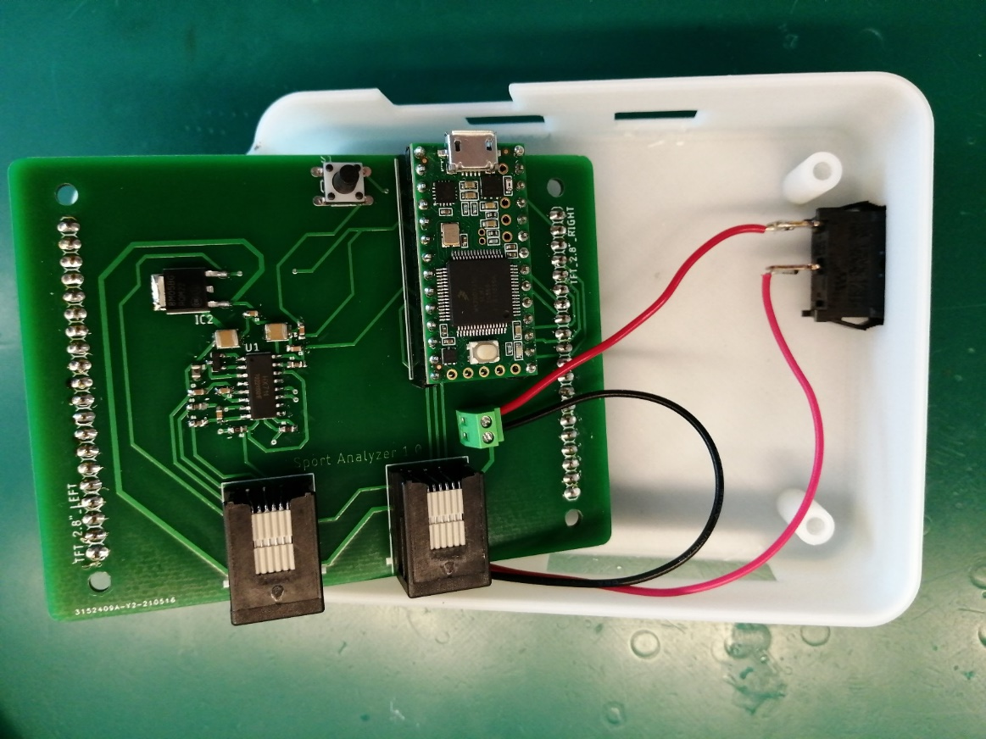
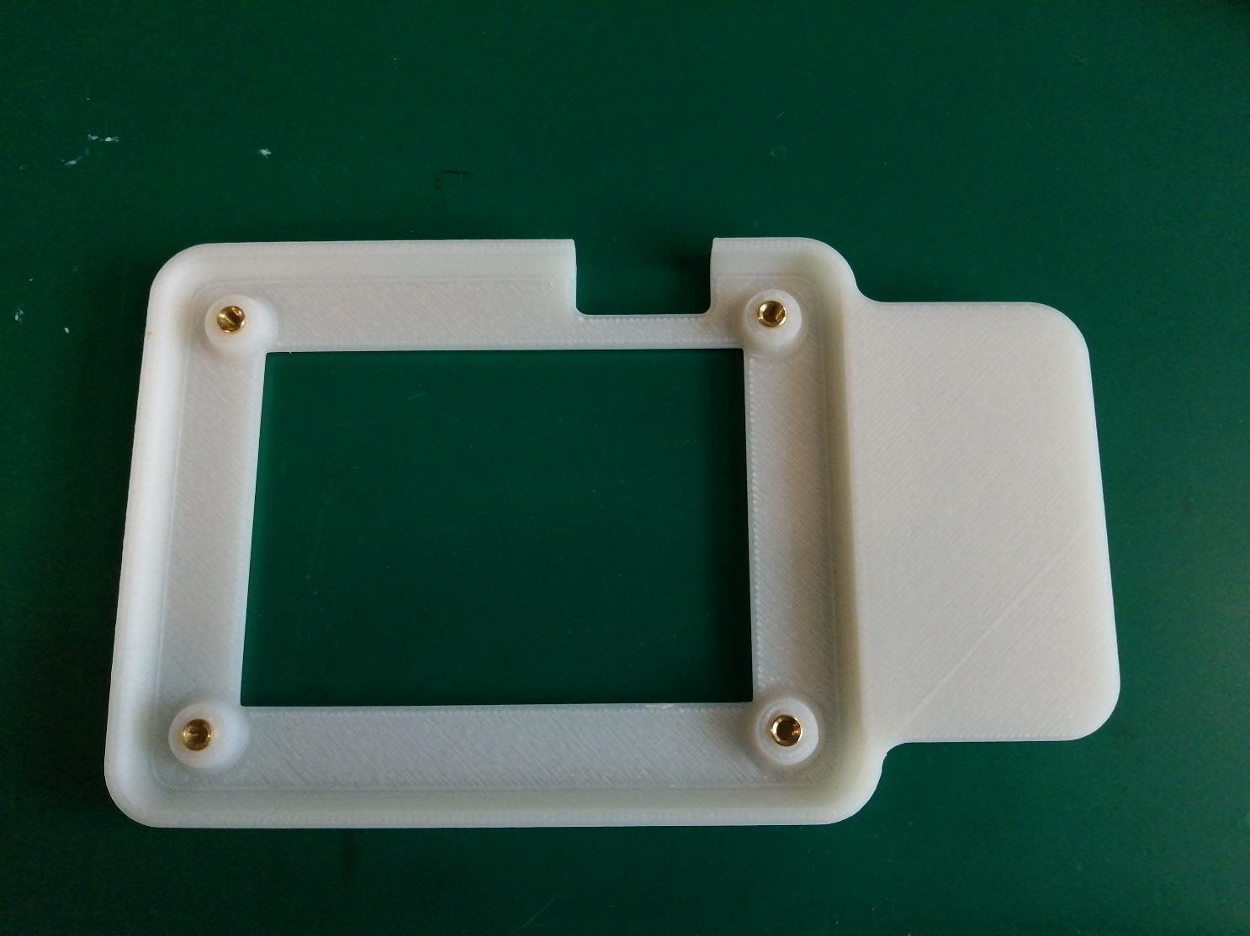
Case manufacturing

Slide 16
Load cell and encoder wiring
RJ12 cable – load cell connection
RJ12 cable – optical encoder connection
Cut the blue wire
Cut the green wire
E+
A+
A-
E-
5V
B
A
GND
Shield
Shield
Load cell wires
Encoder wires

Slide 17
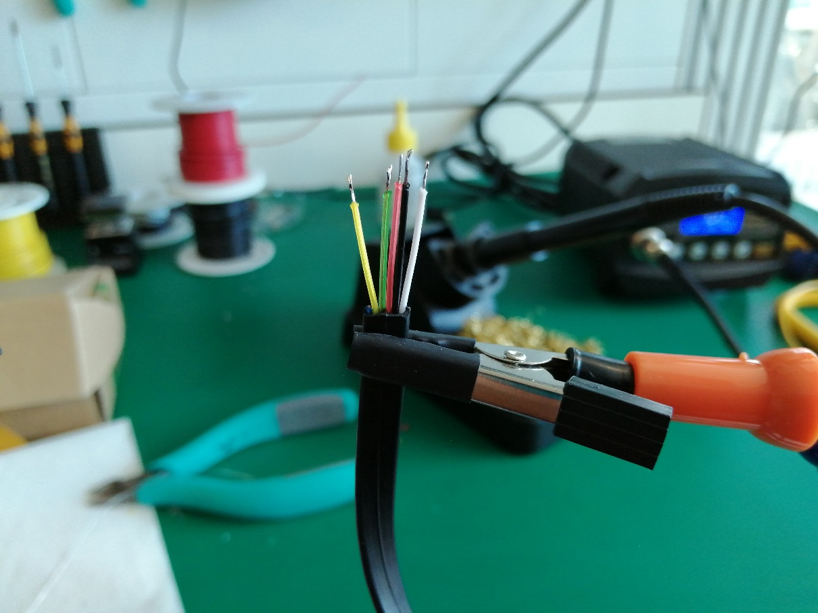
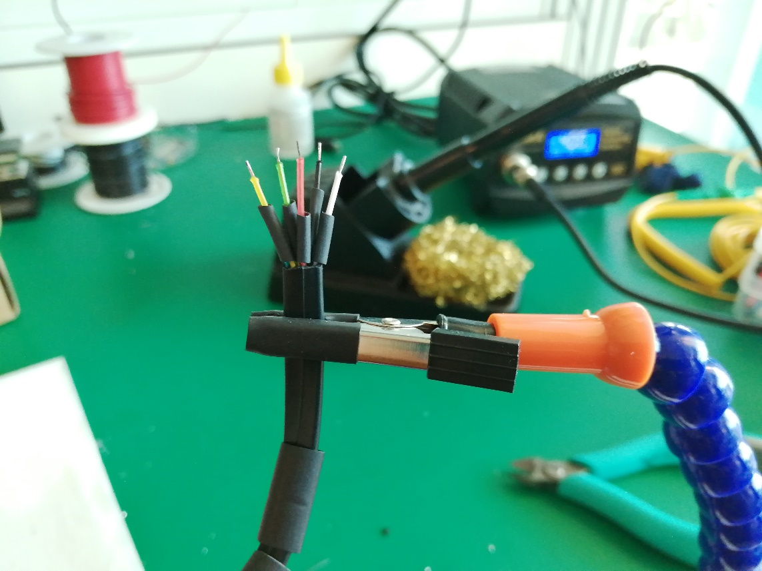
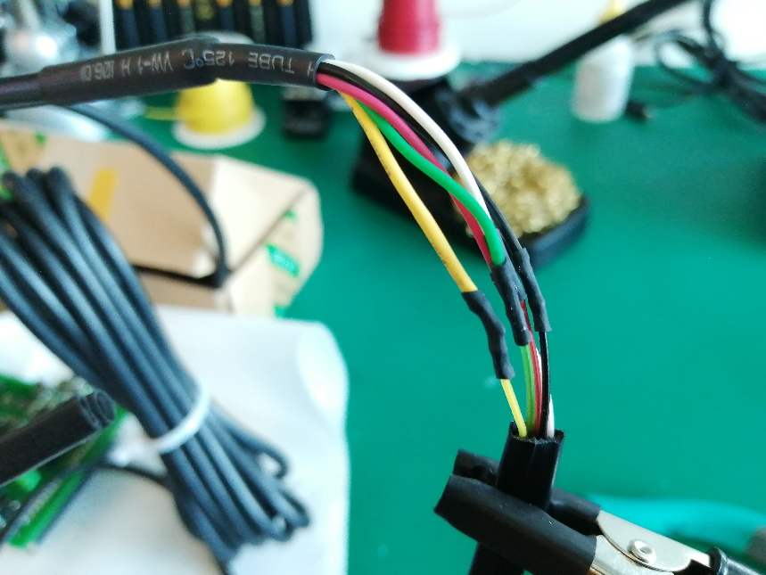
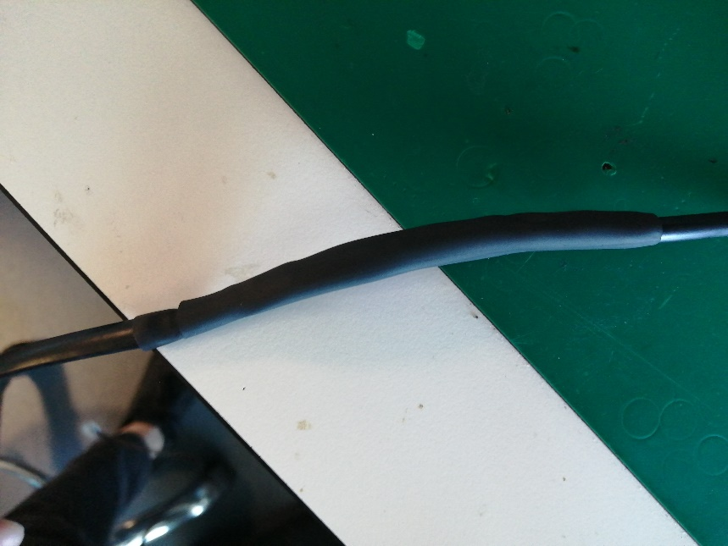
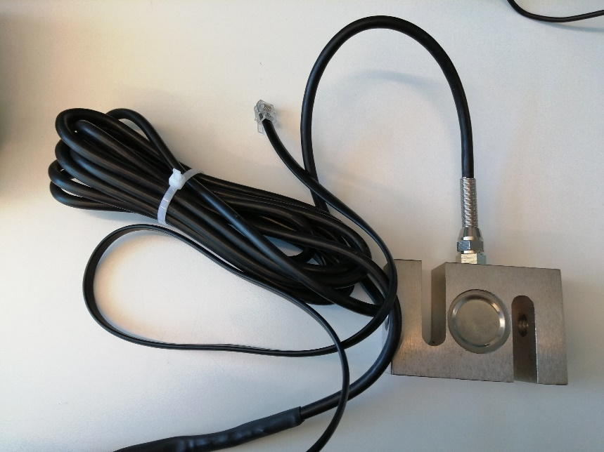
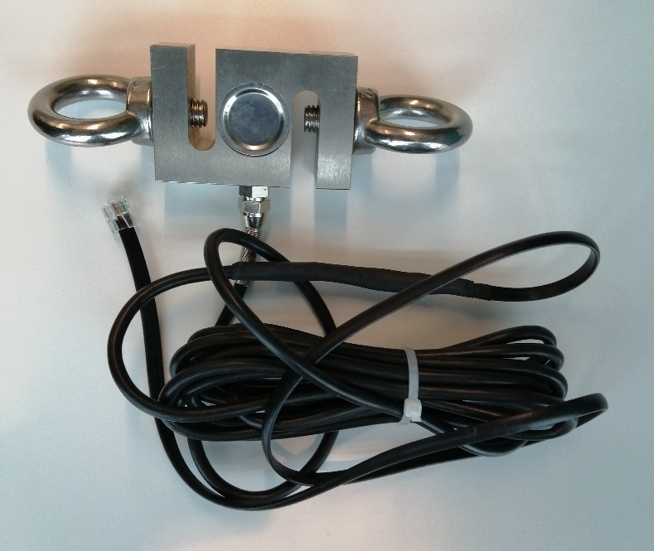
Load cell building process
1
2
3
4
5
6

Slide 18
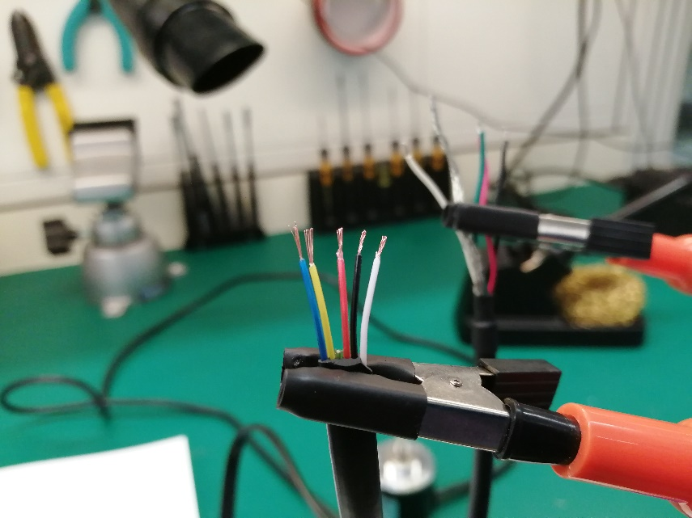
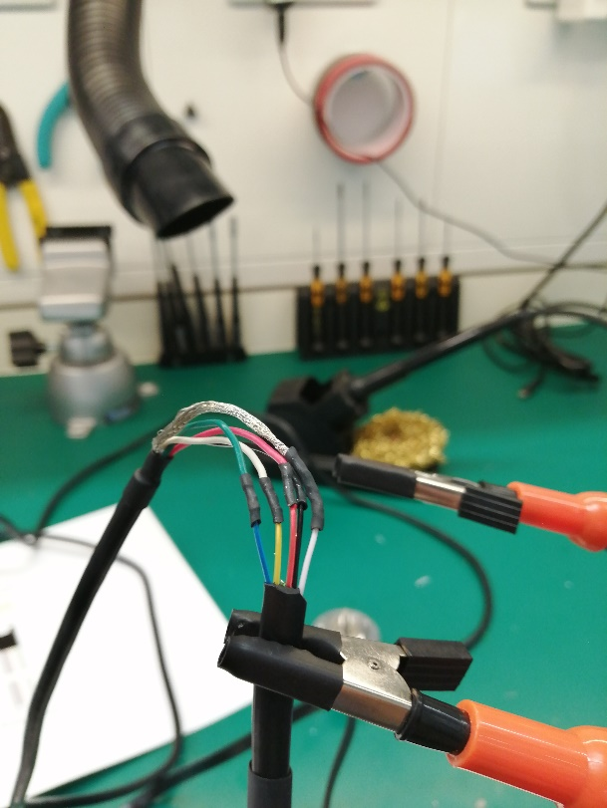
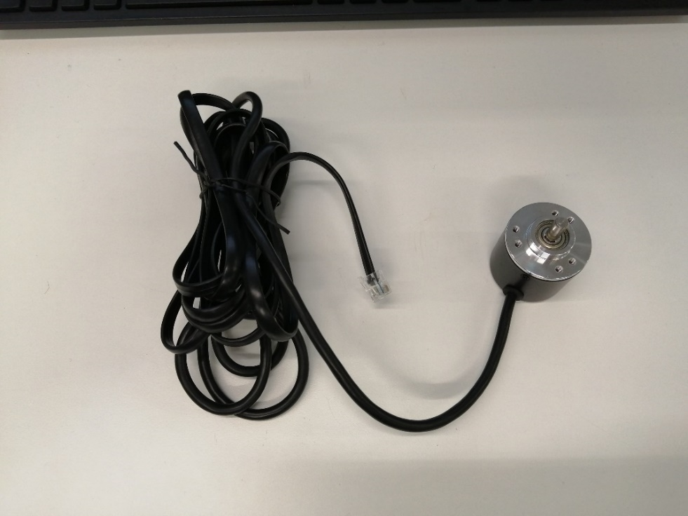
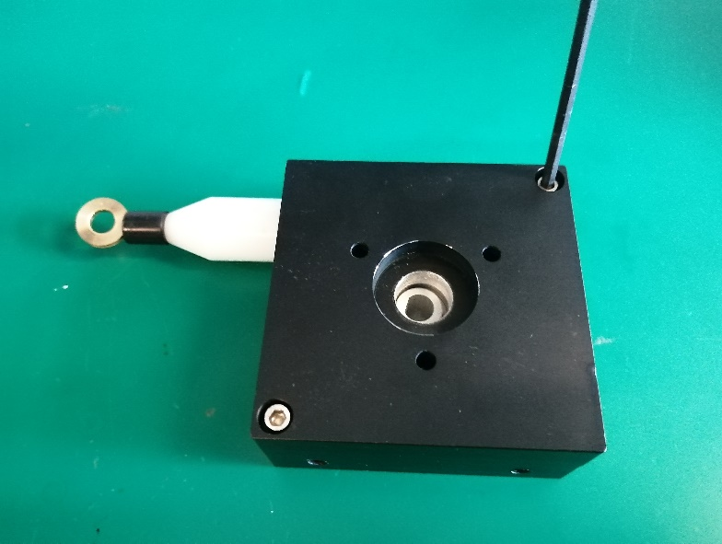
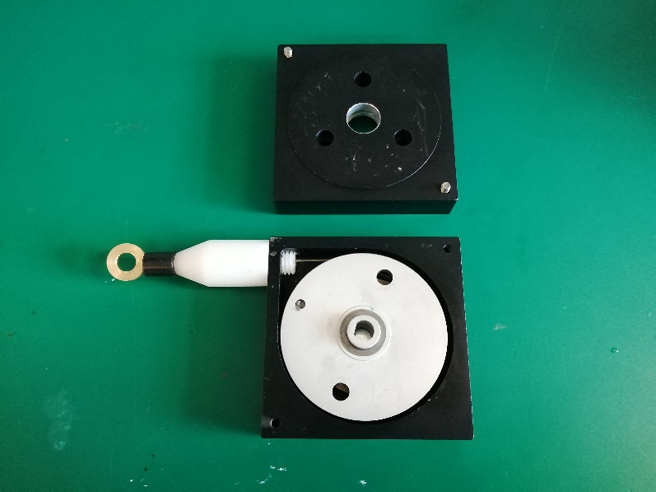
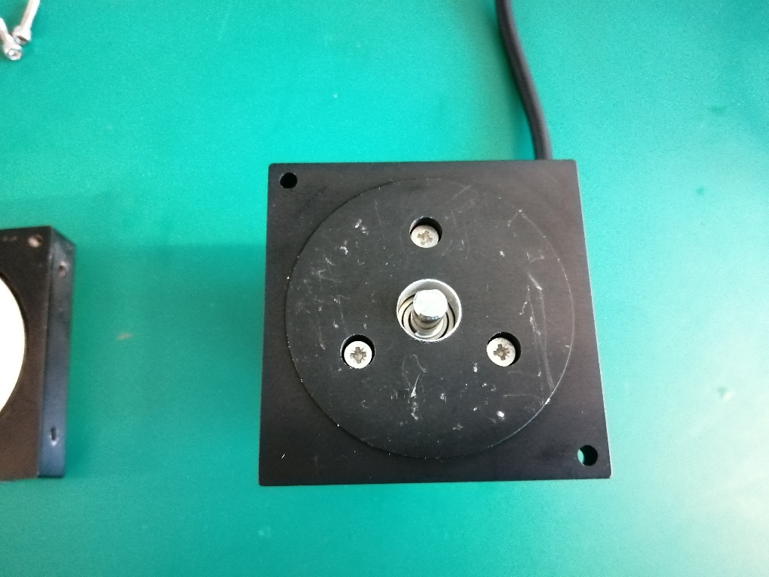
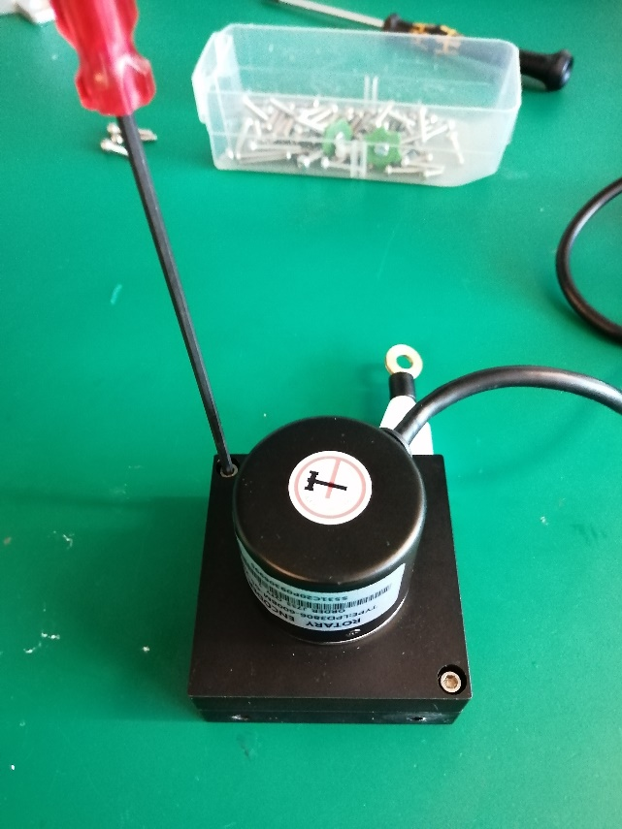
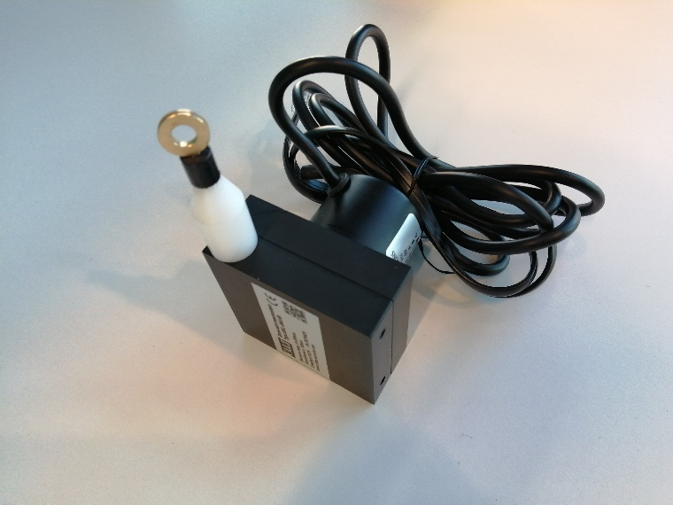
Linear encoder building process
1
2
3
4
5
6
7
8

Slide 19
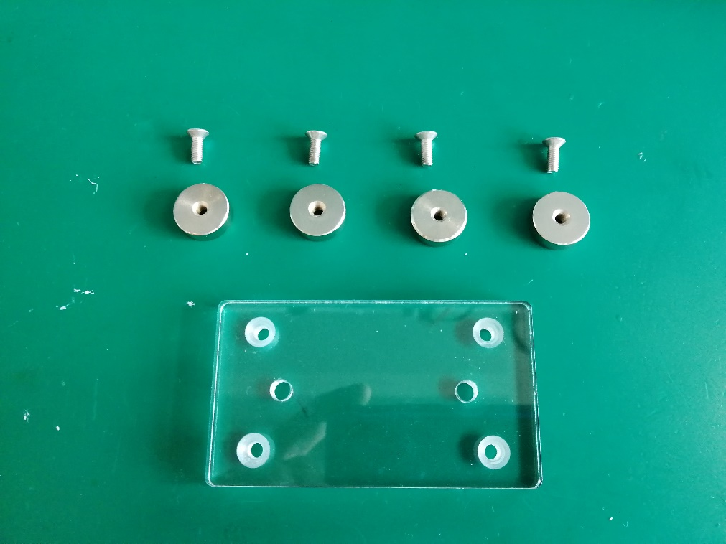
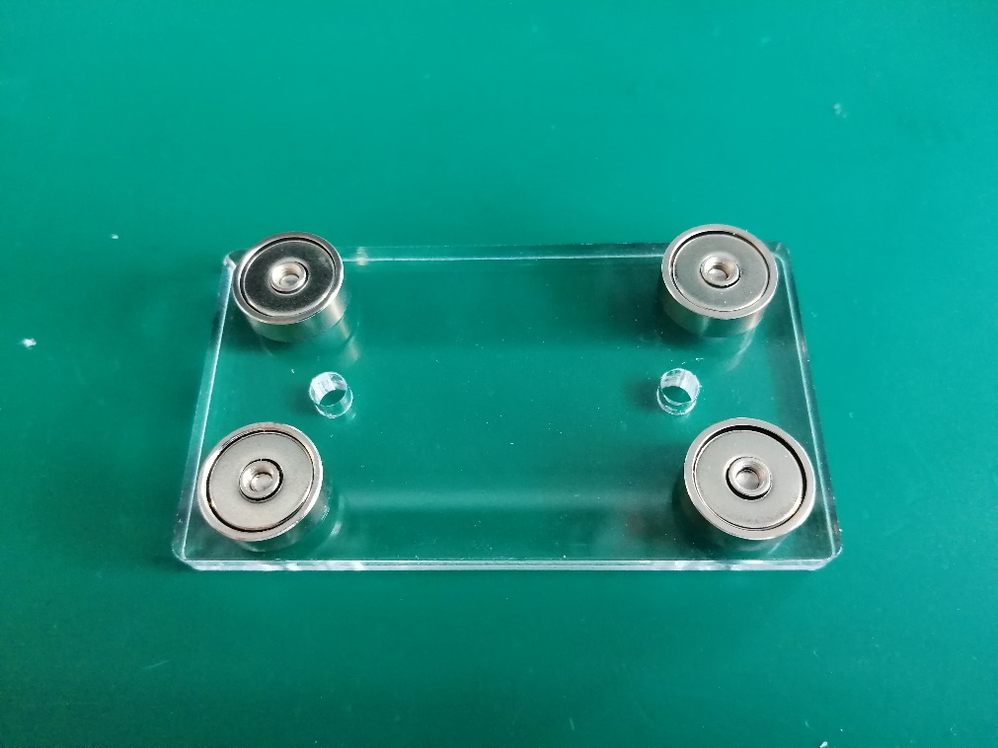
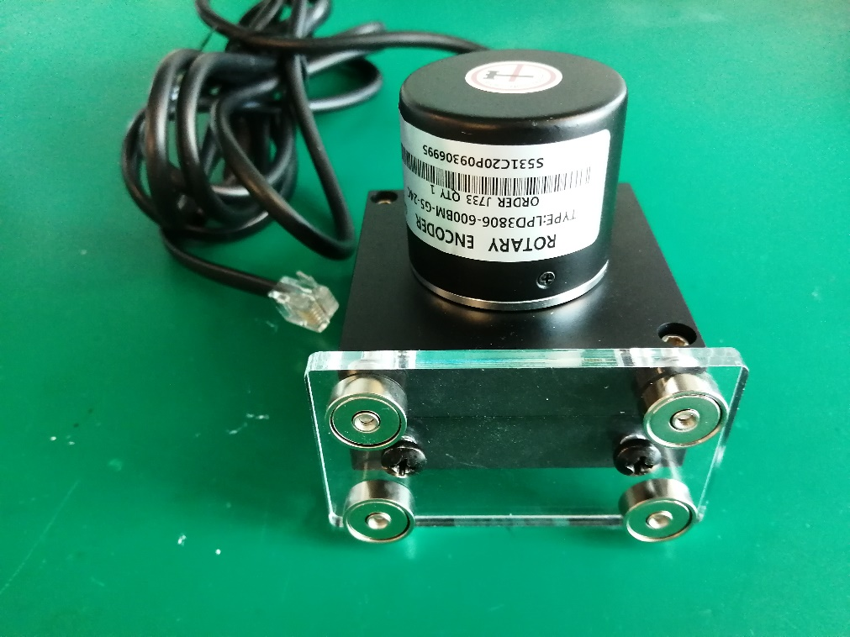
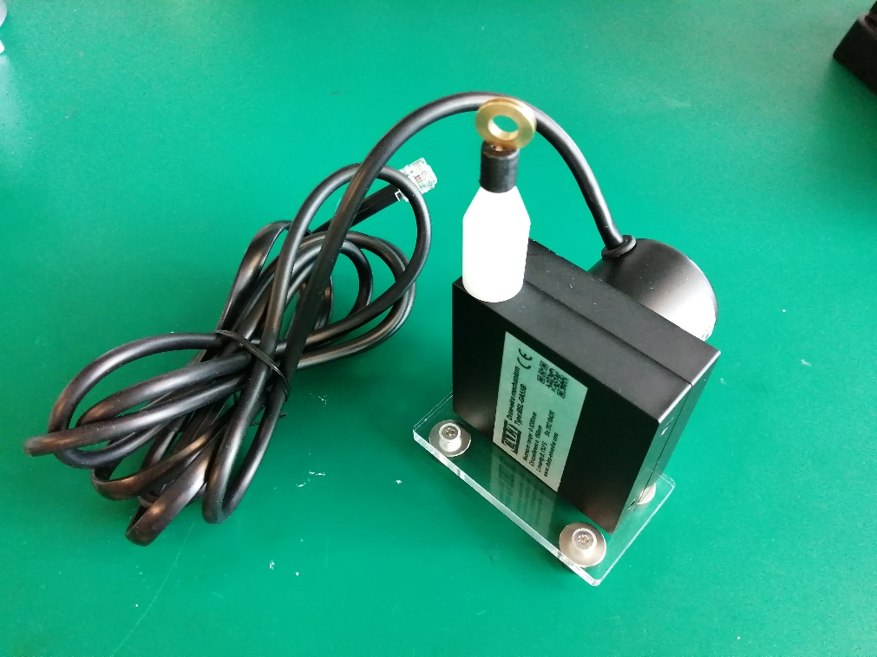
1
2
3
4

Slide 20
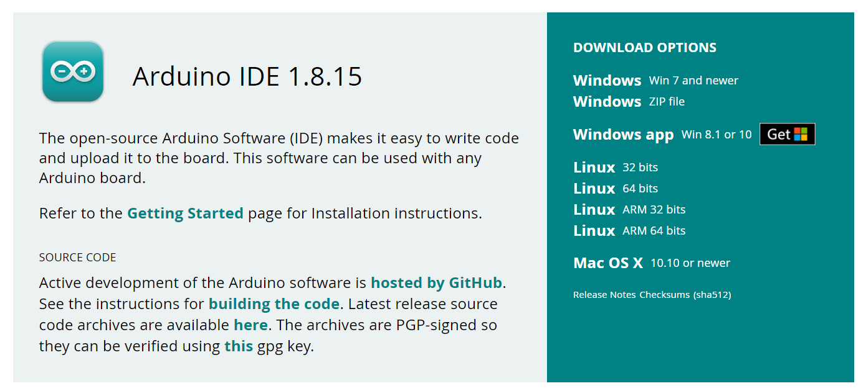
Arduino IDE download
https://www.arduino.cc/en/software

Slide 21
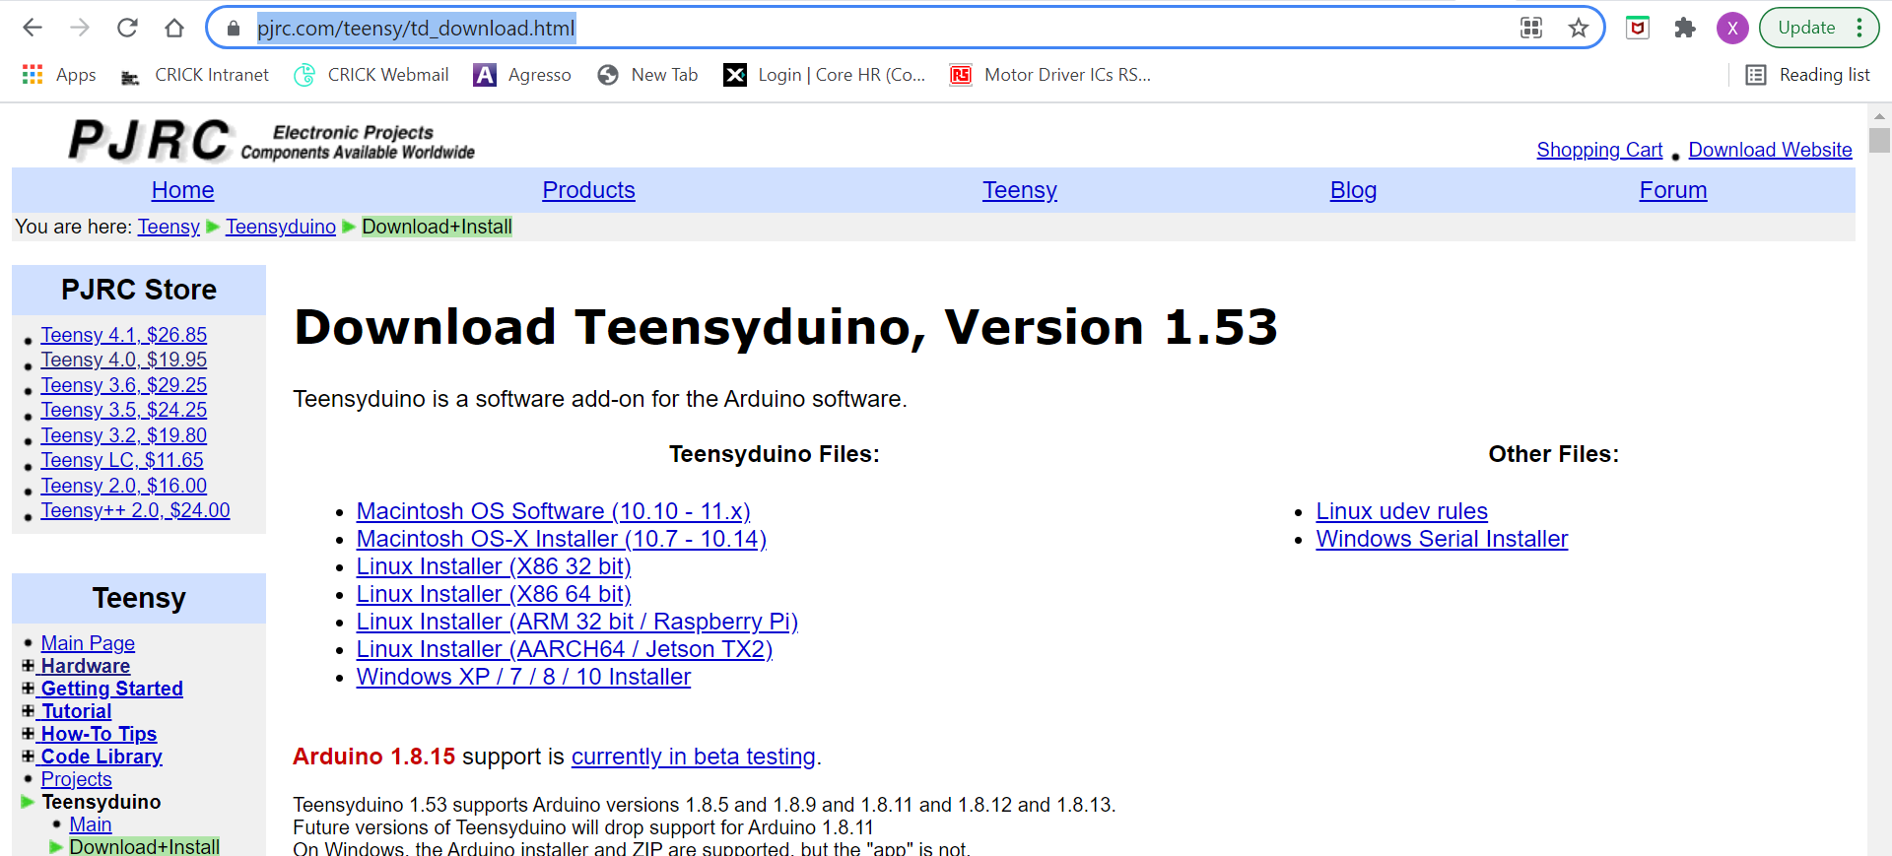
Teensyduino download
https://www.pjrc.com/teensy/td_download.html

Slide 22
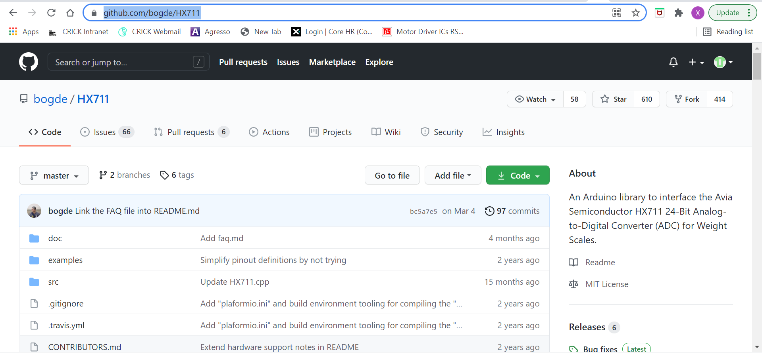
Libraries download
Copy to documents/Arduino/libraries
(.cpp and .h on the folder)
https://github.com/bogde/HX711

Slide 23
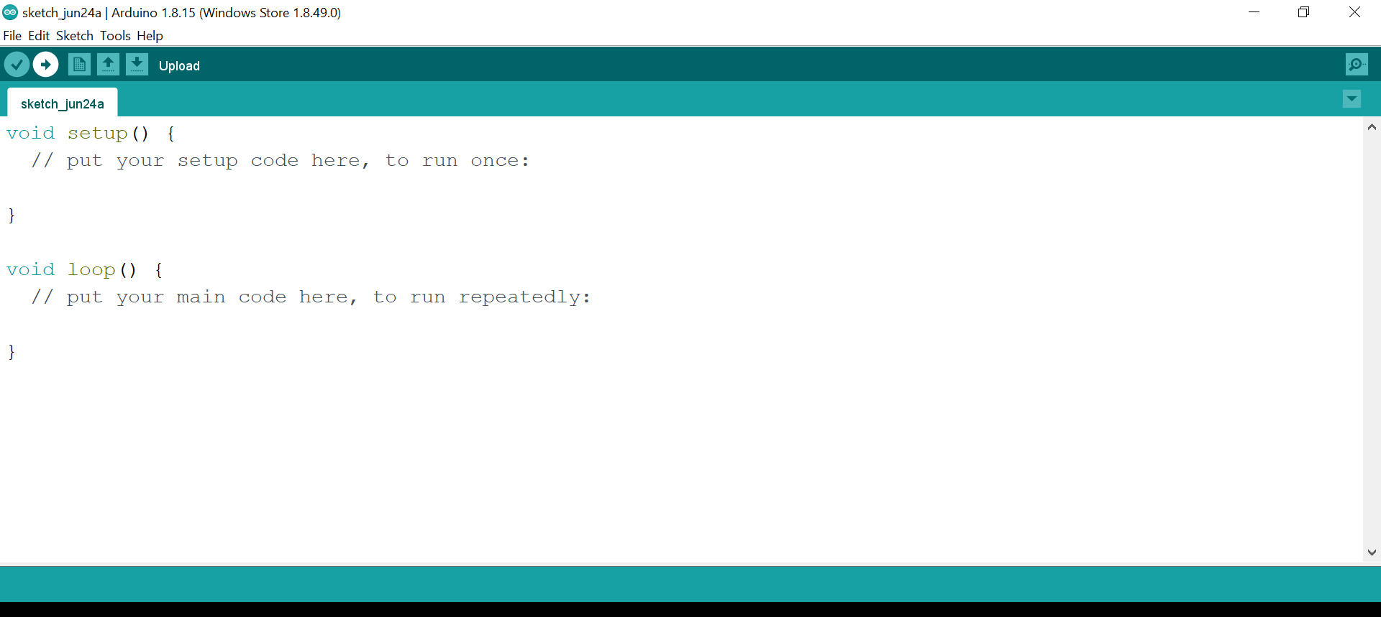
How to upload the firmware
Connect your Arduino using the USB cable. ...
Choose Tools→Board→Arduino Uno to find your board in the Arduino menu. ...
Choose the correct serial port for your board. ... (COM# Teensy 3.2)
Click the Upload button.

Slide 24
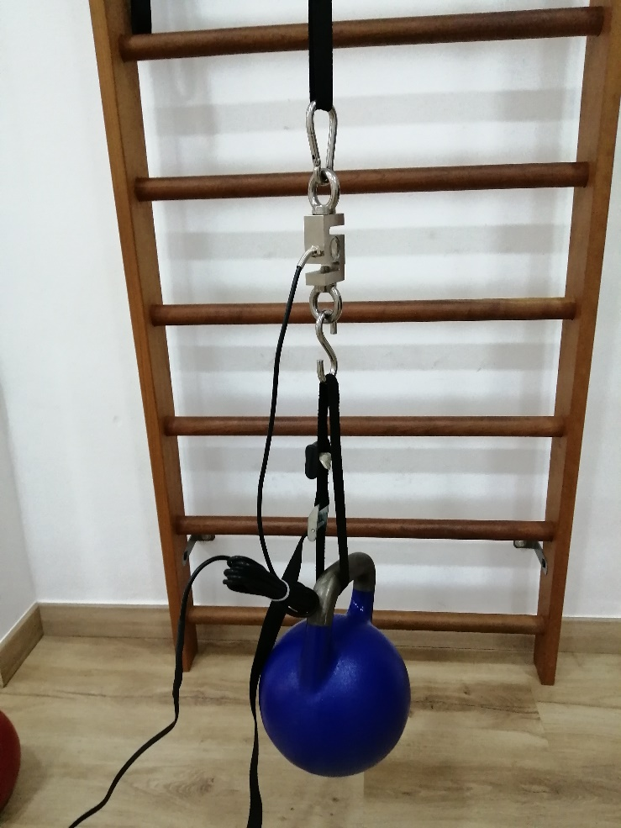
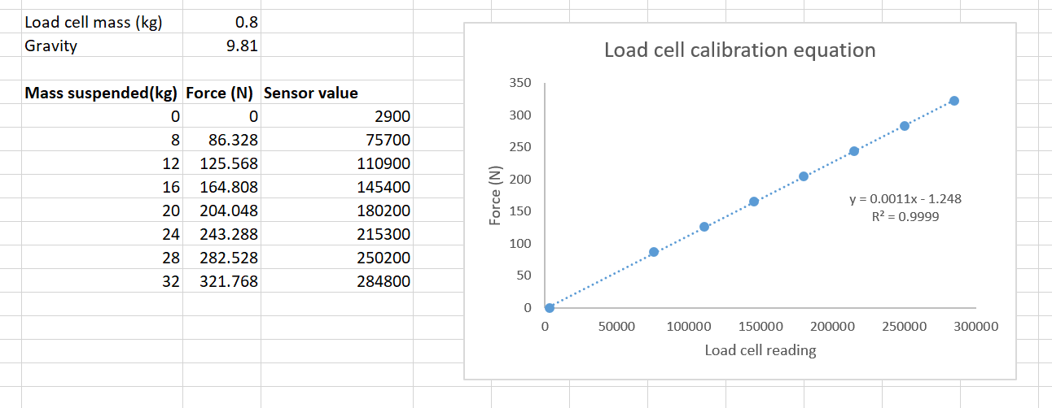
Load cell calibration
Upload Calibration code (Calibration.ino)
The Calibration code will display the raw load cell
and encoder values on the screen:
Open the load cell calibration spreadsheet (Load cell calibration.xlsx)
Attach the load cell between one fixed point and a strap to attach the weights proposed on the spreadsheet. The resulting equation will be introduced on the Sport Analyzer code.

Slide 25
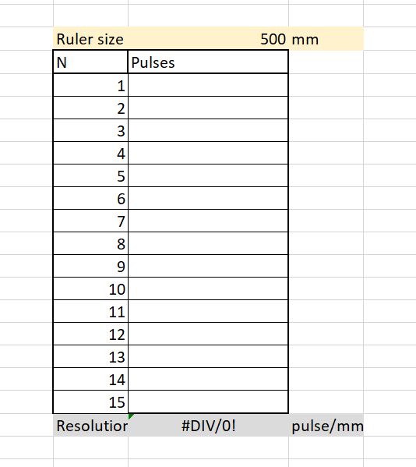
Encoder calibration
Upload Calibration code (Calibration.ino)
The Calibration code will display the raw load cell
and encoder values on the screen:
Open the encoder calibration spreadsheet (Encoder calibration.xlsx)
Use a ruler as a reference to measure the displacement between two points and introduce the ruler size or measurement size and each of the measurements (1-15) on the table.
The resolution in pulses/mm will appear in the bottom of the table

Slide 26
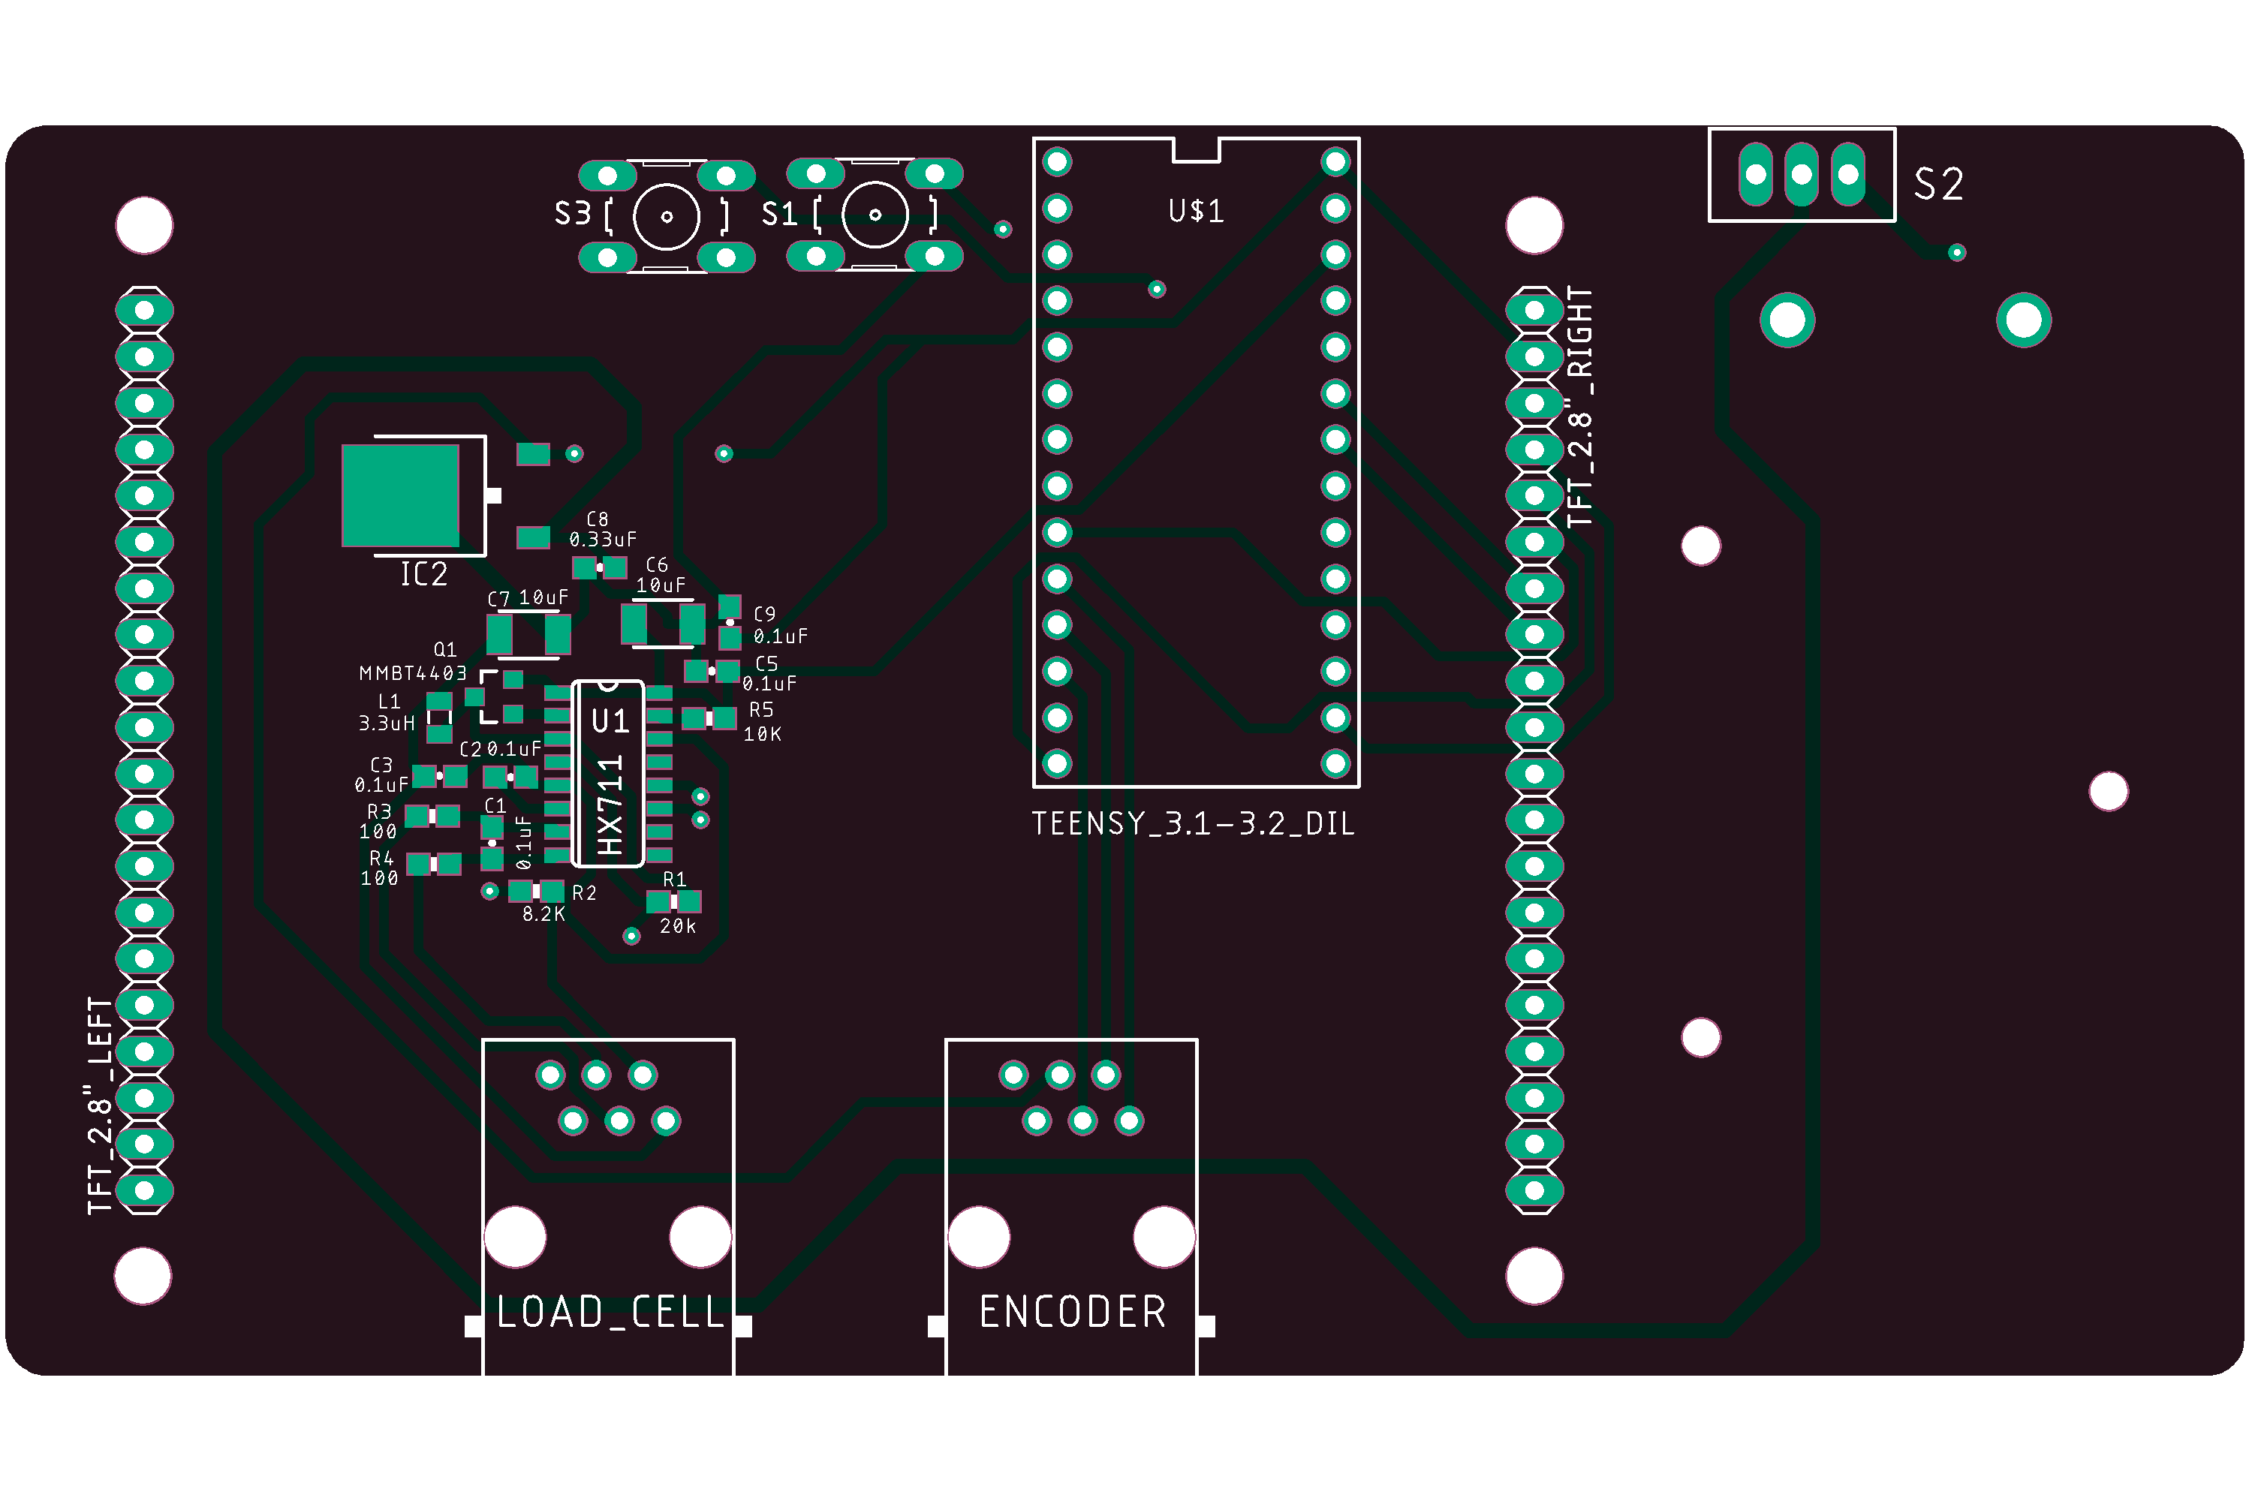
Future versions

Slide 27
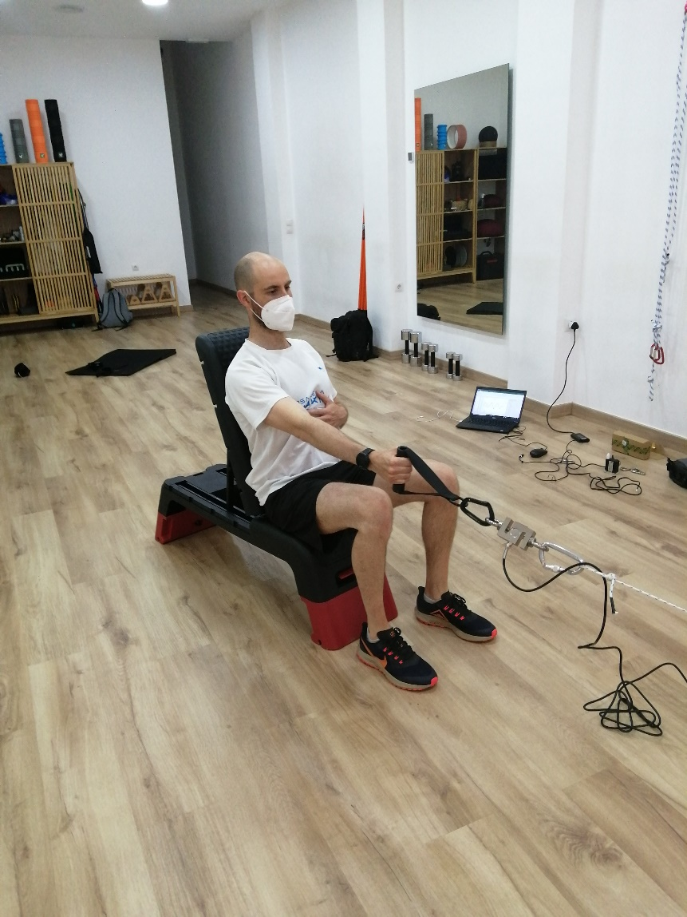

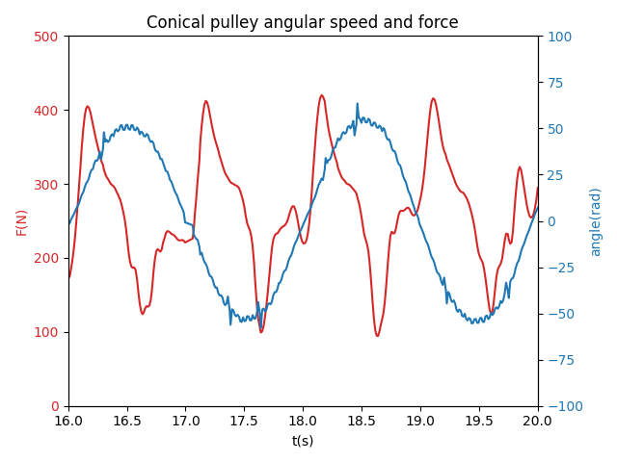
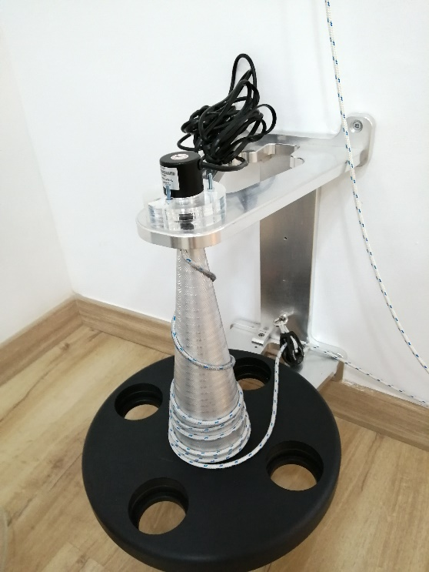
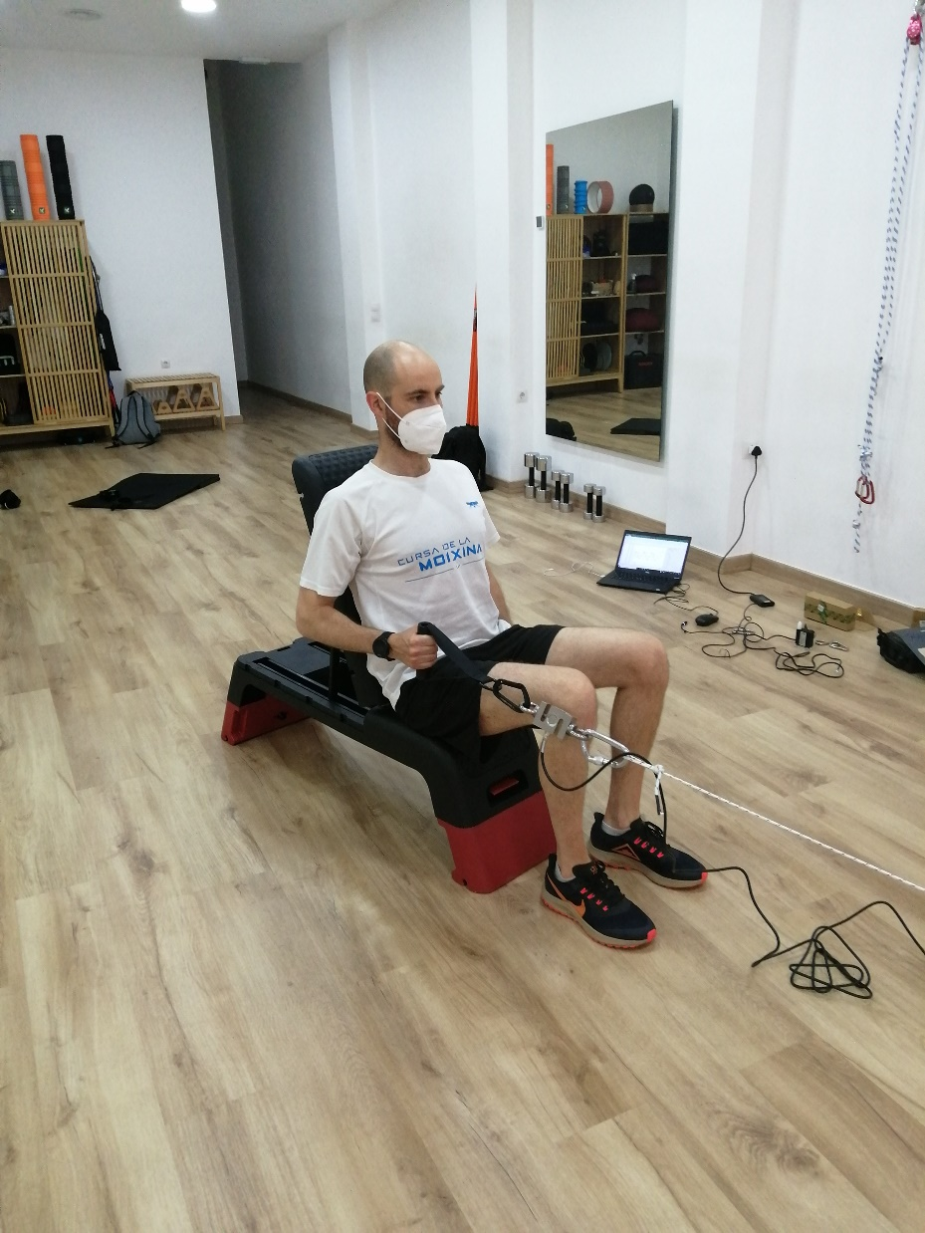
Experimental data: Simultaneous acquisition of speed and force (inertial machine)
Load cell
Incremental encoder

Slide 28


Experimental data: Unilateral Isometric contraction Open kinetic chain (Shoulder external rotation as an example of rehab/functional exercise)

Slide 29


Experimental data: Unilateral mechanical impulse in a Isotonic and closed kinetic chain exercise (Hip extension TRX) (mechanical impulse with two legs)
Concentric
Eccentric

Slide 30
Experimental data: Simultaneous acquisition of speed and force (inertial machine)
Load cell
Incremental encoder

Slide 31
Experimental data: Unilateral Isometric contraction Open kinetic chain (Shoulder external rotation as an example of rehab/functional exercise)

Slide 32
Experimental data: Russian belt impulse increasing load

Slide 33
Experimental data: Unilateral velocity squat jump test

Slide 34
Experimental data: Bosco’s 60s test

Slide 35
Experimental data: Unilateral power output in a closed kinetic chain exercise (TRX row with (Load cell and linear encoder recording)

Slide 36
Experiments and case studies
-Tirant musculador canviant afegint carrega/canviant angle del cos
Politja conica/yoyo squat com a exemple de mesura de F i v simultanea
Test de Bosco com a mesura de caiguda de velocitat amb la fatiga
Mesura de velocitat unilateral (salts a una cama)
Mesura de F isometrica unilateral

